Slide 1

PHP 101: PDO

Slide 2

What is PDO?
PDO == PHP Data Objects
Interface for accessing databases in PHP
Ships with PHP 5.1

Slide 3
Drivers include . . .
MySQL
PostgreSQL
SQL Server
SQLite
and more . . .

Slide 4
Which drivers do I have?
var_dump(PDO::getAvailableDrivers());
If you don’t see what you need, check php.ini

Slide 5
Working with databases
Solved problem, you don’t have to write anything yourself
CRUD is the easy part
Creating clean, maintainable code is the challenge

Slide 6
Let’s look at some typical procedural code

Slide 7
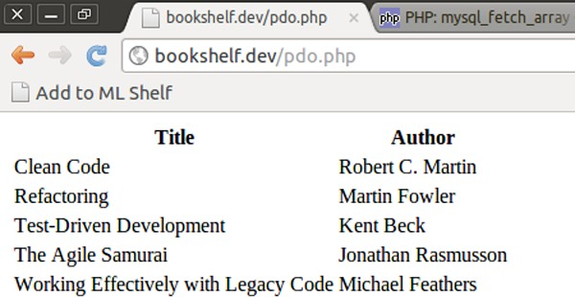
What we’re building

Slide 8
<?php
$dsn = 'mysql:host=localhost;dbname=bookshelf';
$username = 'testuser';
$password = 'testpass';
$options = array(
PDO::ATTR_ERRMODE => PDO::ERRMODE_EXCEPTION, PDO::ATTR_DEFAULT_FETCH_MODE => PDO::FETCH_ASSOC
);
try {
$dbh = new PDO($dsn, $username, $password, $options);
} catch (PDOException $e) {
echo 'Error!: ' . $e->getMessage(); die();
}
// $result is an array, so we can use array functions rather than db vendor functions
$result = $dbh->query('SELECT * FROM bookshelf ORDER BY title')->fetchAll();
?>
<table>
<tr>
<th>Title</th><th>Author</th>
</tr>
<?php
foreach ($result as $row) { echo "<tr>";
echo "<td>{$row['title']}</td><td>{$row['author']}</td>"; echo "</tr>";
}
?>
</table>

Slide 9
<?php
$dsn = 'mysql:host=localhost;dbname=bookshelf';
$username = 'testuser';
$password = 'testpass';
$options = array(
PDO::ATTR_ERRMODE => PDO::ERRMODE_EXCEPTION, PDO::ATTR_DEFAULT_FETCH_MODE => PDO::FETCH_ASSOC
);
try {
$dbh = new PDO($dsn, $username, $password, $options);
} catch (PDOException $e) {
echo 'Error!: ' . $e->getMessage(); die();
}
// $result is an array, so we can use array functions rather than db vendor functions
$result = $dbh->query('SELECT * FROM bookshelf ORDER BY title')->fetchAll();
?>
<table>
<tr>
<th>Title</th><th>Author</th>
</tr>
<?php
foreach ($result as $row) { echo "<tr>";
echo "<td>{$row['title']}</td><td>{$row['author']}</td>"; echo "</tr>";
}
?>
</table>

Slide 10
<?php
$dsn = 'mysql:host=localhost;dbname=bookshelf';
$username = 'testuser';
$password = 'testpass';
$options = array(
PDO::ATTR_ERRMODE => PDO::ERRMODE_EXCEPTION, PDO::ATTR_DEFAULT_FETCH_MODE => PDO::FETCH_ASSOC
);
try {
$dbh = new PDO($dsn, $username, $password, $options);
} catch (PDOException $e) {
echo 'Error!: ' . $e->getMessage(); die();
}
// $result is an array, so we can use array functions rather than db vendor functions
$result = $dbh->query('SELECT * FROM bookshelf ORDER BY title')->fetchAll();
?>
<table>
<tr>
<th>Title</th><th>Author</th>
</tr>
<?php
foreach ($result as $row) { echo "<tr>";
echo "<td>{$row['title']}</td><td>{$row['author']}</td>"; echo "</tr>";
}
?>
</table>

Slide 11
<?php
$dsn = 'mysql:host=localhost;dbname=bookshelf';
$username = 'testuser';
$password = 'testpass';
$options = array(
PDO::ATTR_ERRMODE => PDO::ERRMODE_EXCEPTION, PDO::ATTR_DEFAULT_FETCH_MODE => PDO::FETCH_ASSOC
);
try {
$dbh = new PDO($dsn, $username, $password, $options);
} catch (PDOException $e) {
echo 'Error!: ' . $e->getMessage(); die();
}
// $result is an array, so we can use array functions rather than db vendor functions
$result = $dbh->query('SELECT * FROM bookshelf ORDER BY title')->fetchAll();
?>
<table>
<tr>
<th>Title</th><th>Author</th>
</tr>
<?php
foreach ($result as $row) { echo "<tr>";
echo "<td>{$row['title']}</td><td>{$row['author']}</td>"; echo "</tr>";
}
?>
</table>

Slide 12
<?php
$dsn = 'mysql:host=localhost;dbname=bookshelf';
$username = 'testuser';
$password = 'testpass';
$options = array(
PDO::ATTR_ERRMODE => PDO::ERRMODE_EXCEPTION, PDO::ATTR_DEFAULT_FETCH_MODE => PDO::FETCH_ASSOC
);
try {
$dbh = new PDO($dsn, $username, $password, $options);
} catch (PDOException $e) {
echo 'Error!: ' . $e->getMessage(); die();
}
// $result is an array, so we can use array functions rather than db vendor functions
$result = $dbh->query('SELECT * FROM bookshelf ORDER BY title')->fetchAll();
?>
<table>
<tr>
<th>Title</th><th>Author</th>
</tr>
<?php
foreach ($result as $row) { echo "<tr>";
echo "<td>{$row['title']}</td><td>{$row['author']}</td>"; echo "</tr>";
}
?>
</table>

Slide 13
<?php
$dsn = 'mysql:host=localhost;dbname=bookshelf';
$username = 'testuser';
$password = 'testpass';
$options = array(
PDO::ATTR_ERRMODE => PDO::ERRMODE_EXCEPTION, PDO::ATTR_DEFAULT_FETCH_MODE => PDO::FETCH_ASSOC
);
try {
$dbh = new PDO($dsn, $username, $password, $options);
} catch (PDOException $e) {
echo 'Error!: ' . $e->getMessage(); die();
}
// $result is an array, so we can use array functions rather than db vendor functions
$result = $dbh->query('SELECT * FROM bookshelf ORDER BY title')->fetchAll();
?>
<table>
<tr>
<th>Title</th><th>Author</th>
</tr>
<?php
foreach ($result as $row) { echo "<tr>";
echo "<td>{$row['title']}</td><td>{$row['author']}</td>"; echo "</tr>";
}
?>
</table>

Slide 14
<?php
$dsn = 'mysql:host=localhost;dbname=bookshelf';
$username = 'testuser';
$password = 'testpass';
$options = array(
PDO::ATTR_ERRMODE => PDO::ERRMODE_EXCEPTION, PDO::ATTR_DEFAULT_FETCH_MODE => PDO::FETCH_ASSOC
);
try {
$dbh = new PDO($dsn, $username, $password, $options);
} catch (PDOException $e) {
echo 'Error!: ' . $e->getMessage(); die();
}
// $result is an array, so we can use array functions rather than db vendor functions
$result = $dbh->query('SELECT * FROM bookshelf ORDER BY title')->fetchAll();
?>
<table>
<tr>
<th>Title</th><th>Author</th>
</tr>
<?php
foreach ($result as $row) { echo "<tr>";
echo "<td>{$row['title']}</td><td>{$row['author']}</td>"; echo "</tr>";
}
?>
</table>

Slide 15
Errors and Exceptions
Three error modes
•
•
•
PDO::ERRMODE_SILENT
PDO::ERRMODE_WARNING
PDO::ERRMODE_EXCEPTION
Always use exceptions
No, really, use exceptions

Slide 16
Insert, Update, Delete
PDO::exec()
Returns # rows affected
Won’t return results of SELECT
Won’t escape data (use PDO::quote())

Slide 17
Delete example
/* quote string */
$title = $dbh->quote('Refactoring');
/* Delete a book */
$count = $dbh->exec("DELETE FROM bookshelf WHERE title = $title");
/* Return number of rows that were deleted */ print("Deleted $count rows.\n");

Slide 18
Delete example
/* quote string */
$title = $dbh->quote('Refactoring');
/* Delete a book */
$count = $dbh->exec("DELETE FROM bookshelf WHERE title = $title");
/* Return number of rows that were deleted */ print("Deleted $count rows.\n");

Slide 19
Delete example
/* quote string */
$title = $dbh->quote('Refactoring');
/* Delete a book */
$count = $dbh->exec("DELETE FROM bookshelf WHERE title = $title");
/* Return number of rows that were deleted */ print("Deleted $count rows.\n");

Slide 20
Delete example
/* quote string */
$title = $dbh->quote('Refactoring');
/* Delete a book */
$count = $dbh->exec("DELETE FROM bookshelf WHERE title = $title");
/* Return number of rows that were deleted */ print("Deleted $count rows.\n");

Slide 21
In almost all cases, favor prepared statements over PDO::exec()

Slide 22
Prepared statements
To know them is to love them
No more SQL injection
Can execute same statement multiple times with different values
Efficient (in most cases)
Positional, named
The one feature PDO emulates

Slide 23
Prepared statements
Using named parameters:
$sql = "INSERT INTO bookshelf (title, author) VALUES (:title, :author)";
$statement = $dbh->prepare($sql);
$statement->bindParam('title', $title);
$statement->bindParam('author', $author);
$books = array(
"Clean Code" => "Robert C. Martin", "Refactoring" => "Martin Fowler",
"Test-Driven Development" => "Kent Beck", "The Agile Samurai" => "Jonathan Rasmusson",
"Working Effectively with Legacy Code" => "Michael Feathers"
);
foreach ($books as $title => $author) {
$setup->execute();
}

Slide 24
Prepared statements
Using named parameters:
$sql = "INSERT INTO bookshelf (title, author) VALUES (:title, :author)";
$statement = $dbh->prepare($sql);
$statement->bindParam('title', $title);
$statement->bindParam('author', $author);
$books = array(
"Clean Code" => "Robert C. Martin", "Refactoring" => "Martin Fowler",
"Test-Driven Development" => "Kent Beck", "The Agile Samurai" => "Jonathan Rasmusson",
"Working Effectively with Legacy Code" => "Michael Feathers"
);
foreach ($books as $title => $author) {
$setup->execute();
}

Slide 25
Prepared statements
Using named parameters:
$sql = "INSERT INTO bookshelf (title, author) VALUES (:title, :author)";
$statement = $dbh->prepare($sql);
$statement->bindParam('title', $title);
$statement->bindParam('author', $author);
$books = array(
"Clean Code" => "Robert C. Martin", "Refactoring" => "Martin Fowler",
"Test-Driven Development" => "Kent Beck", "The Agile Samurai" => "Jonathan Rasmusson",
"Working Effectively with Legacy Code" => "Michael Feathers"
);
foreach ($books as $title => $author) {
$setup->execute();
}

Slide 26
Prepared statements
Using named parameters:
$sql = "INSERT INTO bookshelf (title, author) VALUES (:title, :author)";
$statement = $dbh->prepare($sql);
$statement->bindParam('title', $title);
$statement->bindParam('author', $author);
$books = array(
"Clean Code" => "Robert C. Martin", "Refactoring" => "Martin Fowler",
"Test-Driven Development" => "Kent Beck", "The Agile Samurai" => "Jonathan Rasmusson",
"Working Effectively with Legacy Code" => "Michael Feathers"
);
foreach ($books as $title => $author) {
$setup->execute();
}

Slide 27
Prepared statements
Using positional parameters:
$sql = "INSERT INTO bookshelf (title, author) VALUES (?, ?)";
$statement = $dbh->prepare($sql);
$statement->bindParam(1, $title);
$statement->bindParam(2, $author);
$books = array(
"Clean Code" => "Robert C. Martin", "Refactoring" => "Martin Fowler",
"Test-Driven Development" => "Kent Beck", "The Agile Samurai" => "Jonathan Rasmusson",
"Working Effectively with Legacy Code" => "Michael Feathers"
);
foreach ($books as $title => $author) {
$setup->execute();
}

Slide 28
Prepared statements
Array of named params to PDO::execute
$sql = "INSERT INTO bookshelf (title, author) VALUES (:title, :author)";
$statement = $dbh->prepare($sql);
$statement->execute(array('title' => $title, 'author' => $author));

Slide 29
Prepared statements
Array of named params to PDO::execute
$sql = "INSERT INTO bookshelf (title, author) VALUES (:title, :author)";
$statement = $dbh->prepare($sql);
$statement->execute(array('title' => $title, 'author' => $author));

Slide 30
Prepared statements
Array of named params to PDO::execute
$sql = "INSERT INTO bookshelf (title, author) VALUES (:title, :author)";
$statement = $dbh->prepare($sql);
$statement->execute(array('title' => $title, 'author' => $author));

Slide 31
Select
Gets data from the database
Results returned as PDO Statement
How data is fetched from statement depends on fetch mode
Grab all results at once with fetchAll()

Slide 32
Fetch modes
Can be set in constructor or later with PDO::setAttribute() or PDOStatement::setFetchMode()
PDO::FETCH_ASSOC
PDO::FETCH_BOTH (default)
PDO::FETCH_NUM
PDO::FETCH_OBJ
to name a few . . .

Slide 33
Fetching
// Gets | all books in database
$stmt = | $dbh->query("SELECT * FROM | bookshelf | ORDER | BY | title");
// Returns array of all results
$books = $stmt->fetchAll();
// Returns next row in manner determined by fetch mode
$row = $stmt->fetch();
// Can choose fetch mode at time of fetch
$row = $stmt->fetch(PDO::FETCH_OBJ);

Slide 34
Fetching
// Gets | all books in database
$stmt = | $dbh->query("SELECT * FROM | bookshelf | ORDER | BY | title");
// Returns array of all results
$books = $stmt->fetchAll();
// Returns next row in manner determined by fetch mode
$row = $stmt->fetch();
// Can choose fetch mode at time of fetch
$row = $stmt->fetch(PDO::FETCH_OBJ);

Slide 35
Fetching
// Gets | all books in database
$stmt = | $dbh->query("SELECT * FROM | bookshelf | ORDER | BY | title");
// Returns array of all results
$books = $stmt->fetchAll();
// Returns next row in manner determined by fetch mode
$row = $stmt->fetch();
// Can choose fetch mode at time of fetch
$row = $stmt->fetch(PDO::FETCH_OBJ);

Slide 36
Fetching
// Gets | all books in database
$stmt = | $dbh->query("SELECT * FROM | bookshelf | ORDER | BY | title");
// Returns array of all results
$books = $stmt->fetchAll();
// Returns next row in manner determined by fetch mode
$row = $stmt->fetch();
// Can choose fetch mode at time of fetch
$row = $stmt->fetch(PDO::FETCH_OBJ);

Slide 37
Fetching
// Gets | all books in database
$stmt = | $dbh->query("SELECT * FROM | bookshelf | ORDER | BY | title");
// Returns array of all results
$books = $stmt->fetchAll();
// Returns next row in manner determined by fetch mode
$row = $stmt->fetch();
// Can choose fetch mode at time of fetch
$row = $stmt->fetch(PDO::FETCH_OBJ);

Slide 38
Fetching
PDOStatement implements Traversable, which allows you to:
$stmt = $dbh->query('SELECT * FROM bookshelf ORDER BY title');
?>
<table>
<tr>
<th>Title</th><th>Author</th>
</tr>
<?php
foreach ($stmt as $row) { echo "<tr>";
echo "<td>{$row['title']}</td><td>{$row['author']}</td>"; echo "</tr>";
}
?>
</table>

Slide 39
Fetching
PDOStatement implements Traversable, which allows you to:
$stmt = $dbh->query('SELECT * FROM bookshelf ORDER BY title');
?>
<table>
<tr>
<th>Title</th><th>Author</th>
</tr>
<?php
foreach ($stmt as $row) { echo "<tr>";
echo "<td>{$row['title']}</td><td>{$row['author']}</td>"; echo "</tr>";
}
?>
</table>

Slide 40
Fetching
PDO::FETCH_BOUND is slick
$stmt = $dbh->query('SELECT id, title, author FROM bookshelf ORDER BY title');
$stmt->bindColumn('title', $title);
$stmt->bindColumn('author', $author);
?>
<table>
<tr>
<th>Title</th><th>Author</th>
</tr>
<?php
while ($stmt->fetch(PDO::FETCH_BOUND)) { echo "<tr>";
echo "<td>$title</td><td>$author</td>"; echo "</tr>";
}
?>
</table>

Slide 41
Fetching
PDO::FETCH_BOUND is slick
$stmt = $dbh->query('SELECT id, title, author FROM bookshelf ORDER BY title');
$stmt->bindColumn('title', $title);
$stmt->bindColumn('author', $author);
?>
<table>
<tr>
<th>Title</th><th>Author</th>
</tr>
<?php
while ($stmt->fetch(PDO::FETCH_BOUND)) { echo "<tr>";
echo "<td>$title</td><td>$author</td>"; echo "</tr>";
}
?>
</table>

Slide 42
Fetching
PDO::FETCH_BOUND is slick
$stmt = $dbh->query('SELECT id, title, author FROM bookshelf ORDER BY title');
$stmt->bindColumn('title', $title);
$stmt->bindColumn('author', $author);
?>
<table>
<tr>
<th>Title</th><th>Author</th>
</tr>
<?php
while ($stmt->fetch(PDO::FETCH_BOUND)) { echo "<tr>";
echo "<td>$title</td><td>$author</td>"; echo "</tr>";
}
?>
</table>

Slide 43
CRUD Operations

Slide 44
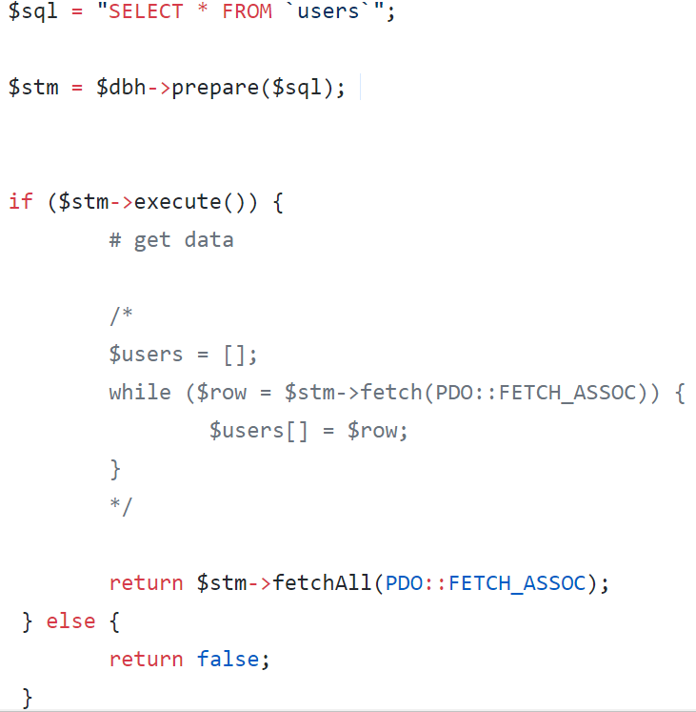
Select All

Slide 45
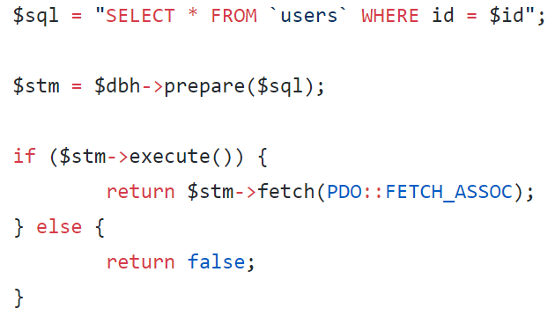
Select By ID

Slide 46
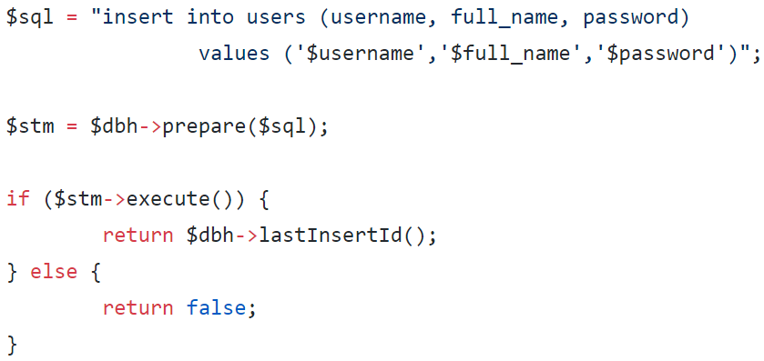
Insert

Slide 47
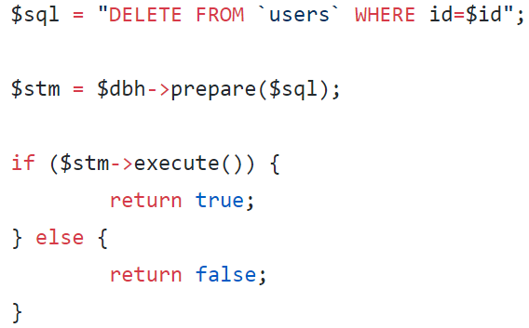
Delete

Slide 48
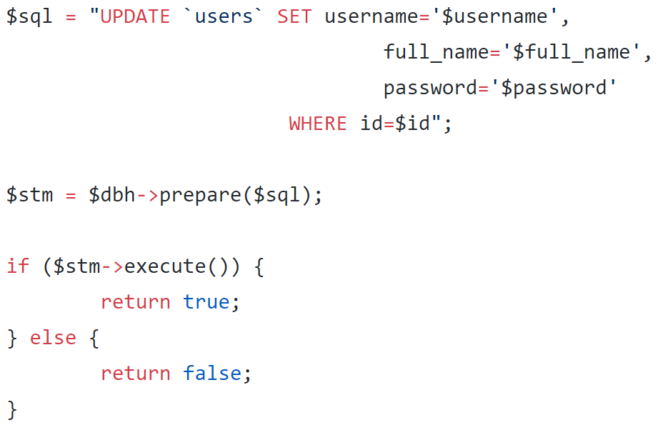
Update

